Slide 1
Picture Talker
Group - 112
Xiaoran Luo 11935816
Pei Ying Wu 12987196
Jiajie Huang 13015488
Weihan Zeng 13023128

Slide 2
Agenda
Target Audient
How problem is being solved
Demo
Framework
Product Design Cycle

Slide 3
Target Audient
Non-English speakers who want to know the English word for objects in a fun and intuitive way

Slide 4
How problem is being solved
Take a picture of the object
Machine Learining does the dirty job to process the image
App will show users the English word

Slide 5
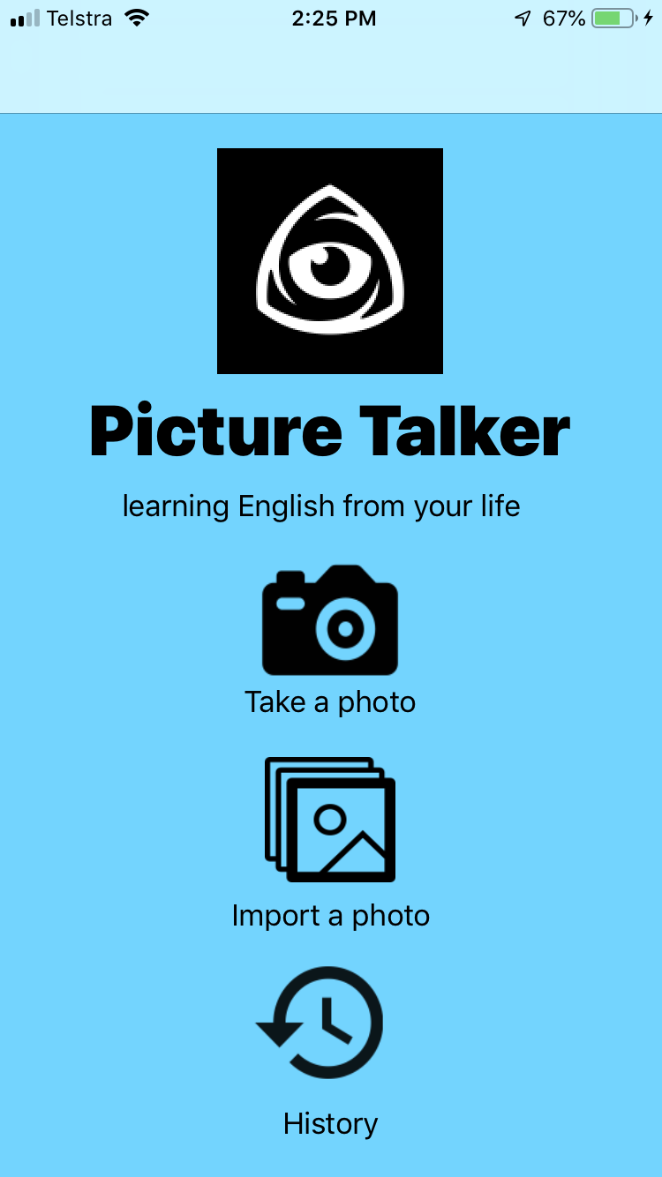

Demo

Slide 6
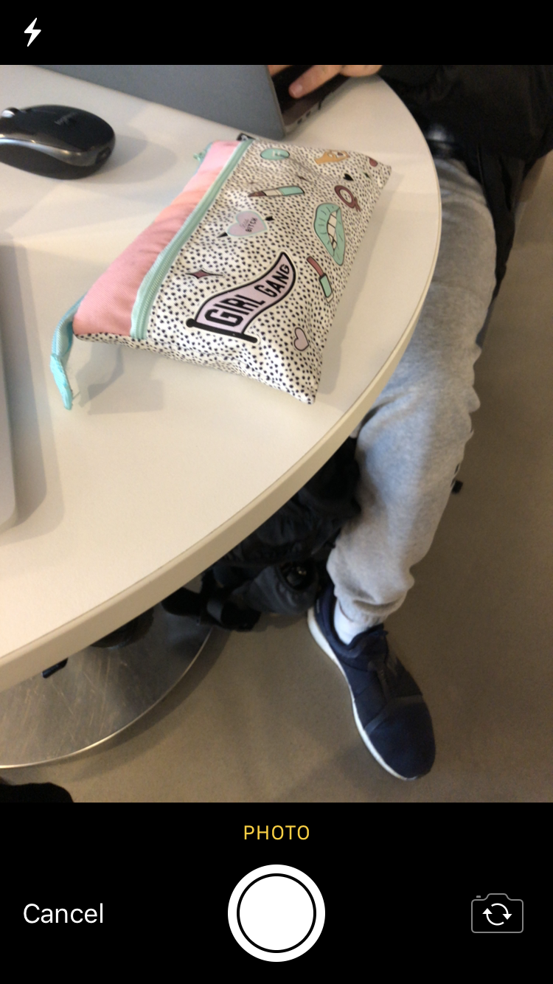
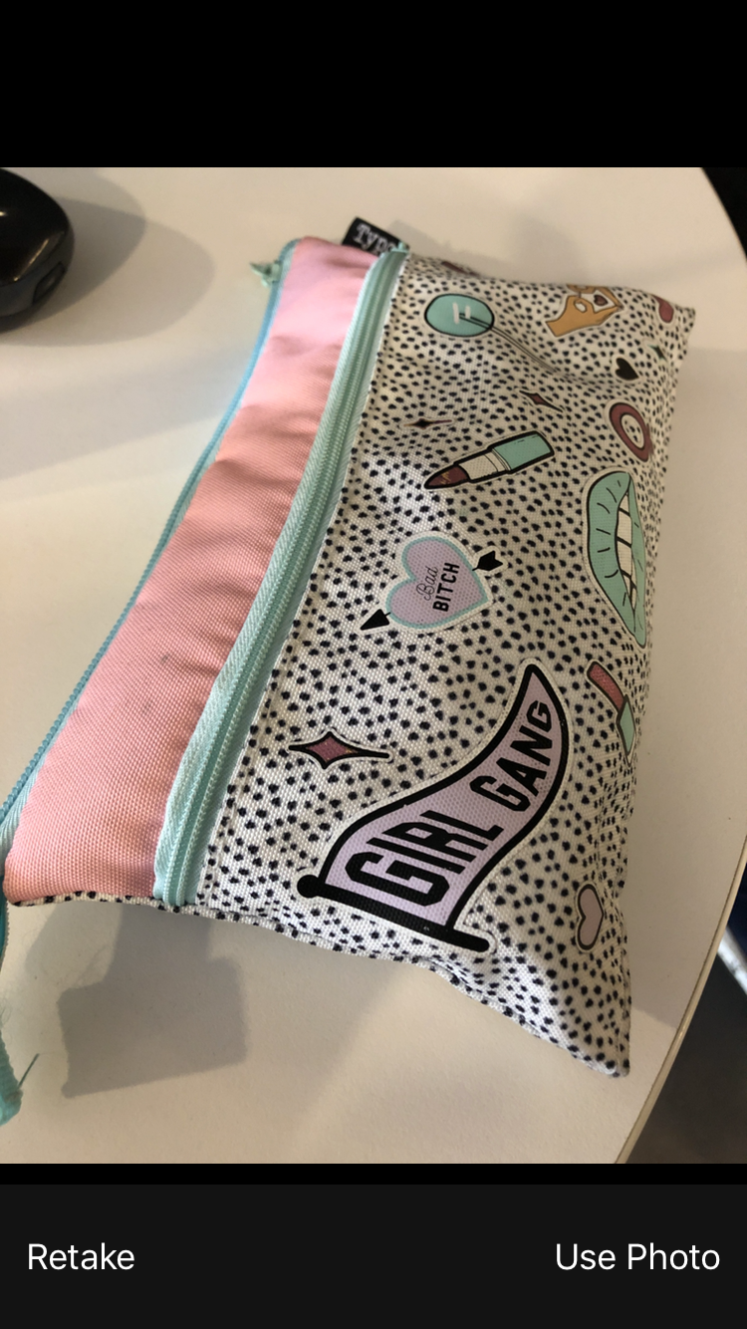
Take a Photo - 1

Slide 7
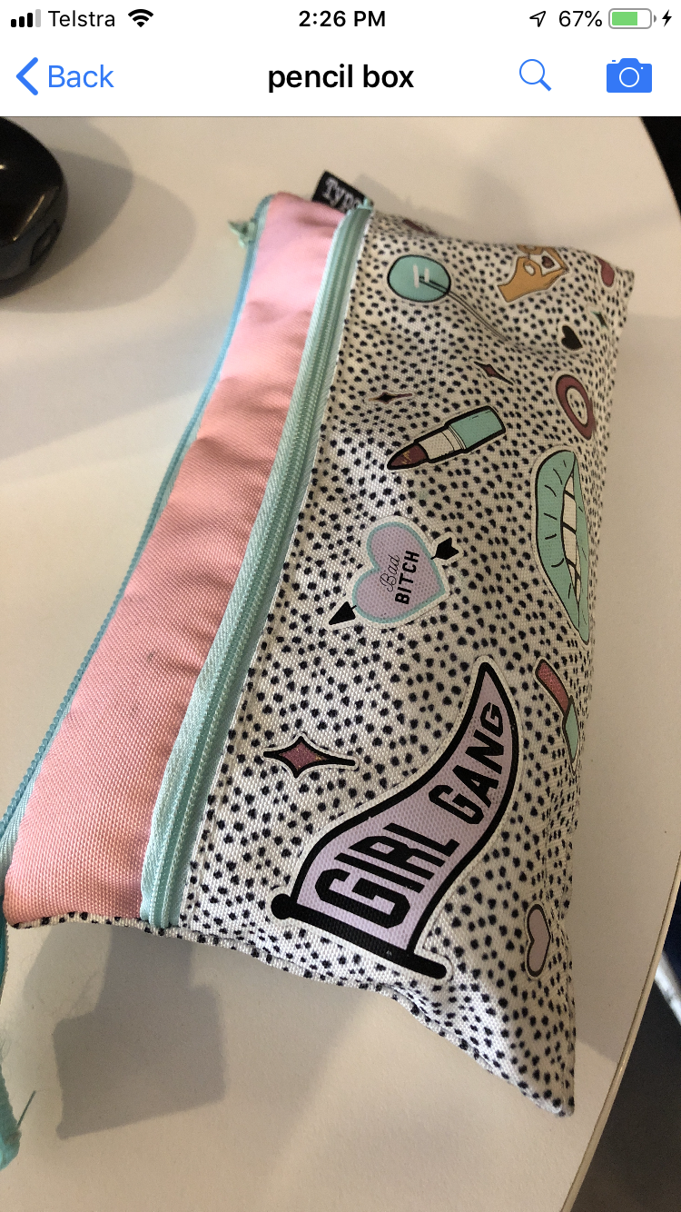
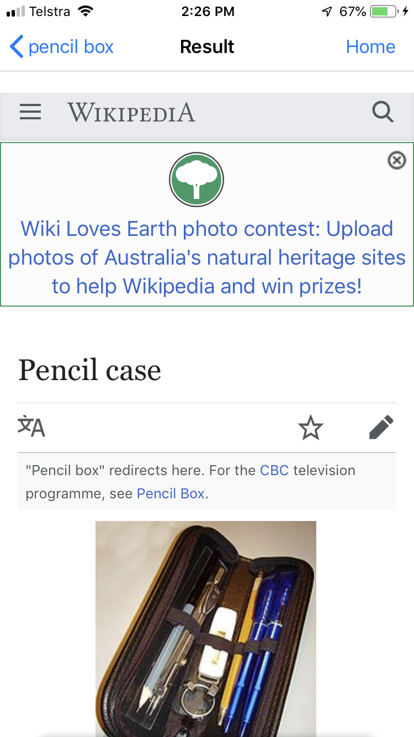
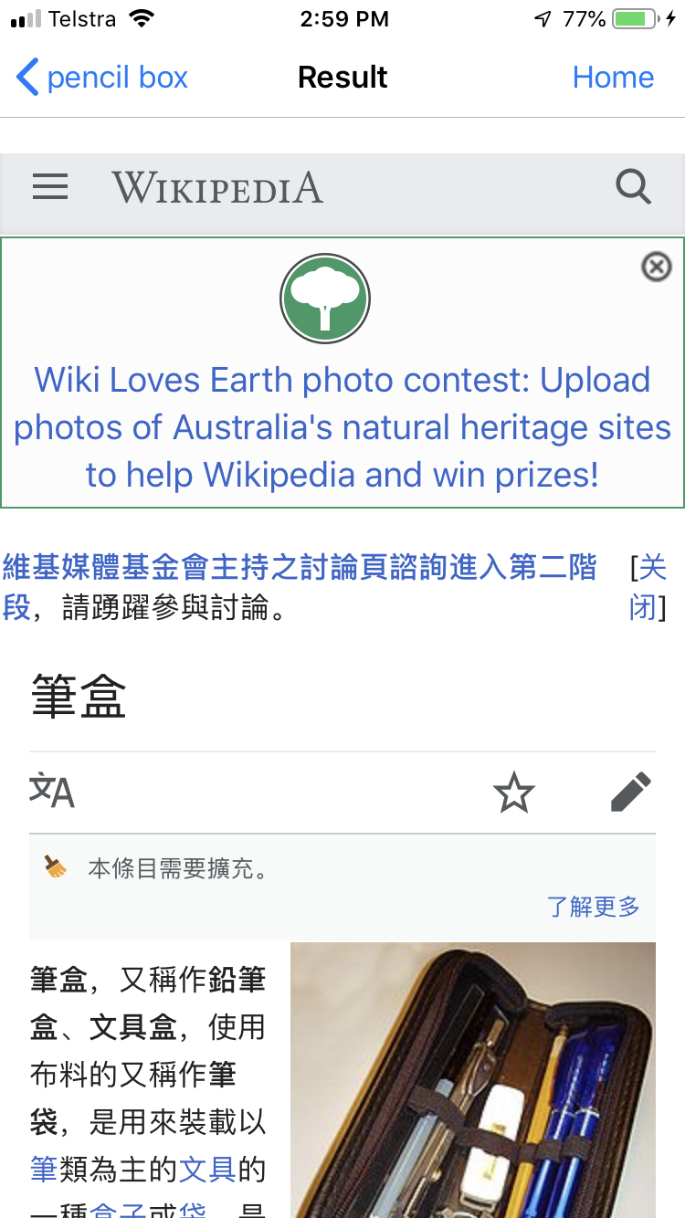
Take a Photo - 2

Slide 8

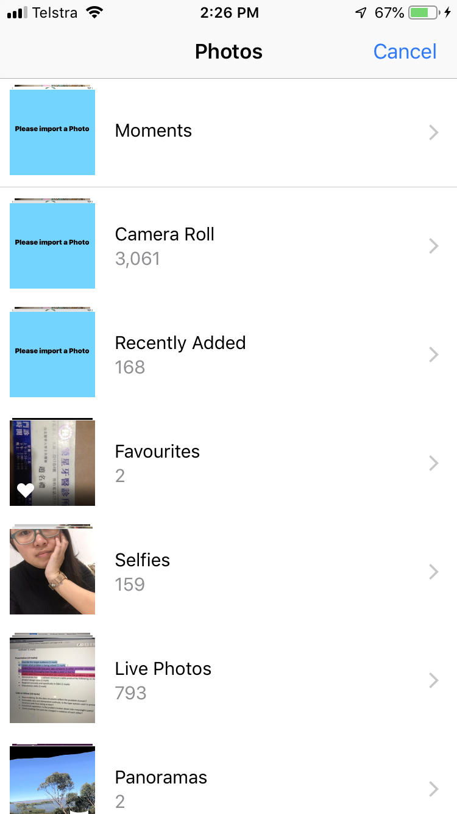
Import a Photo - 1

Slide 9
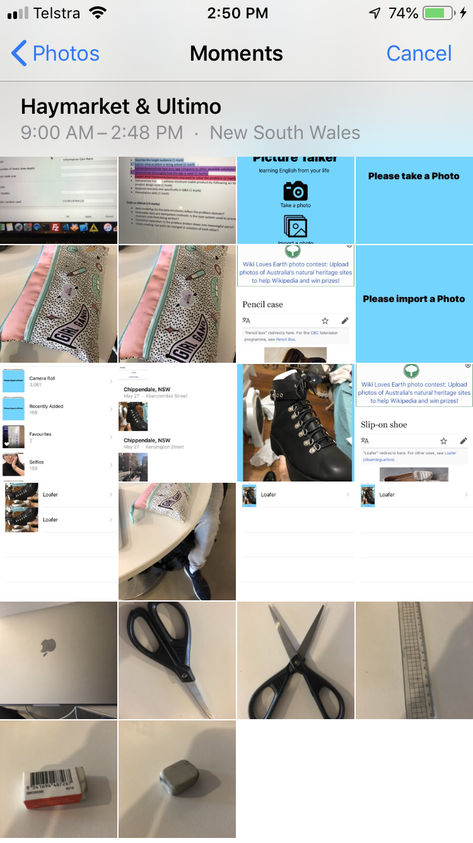
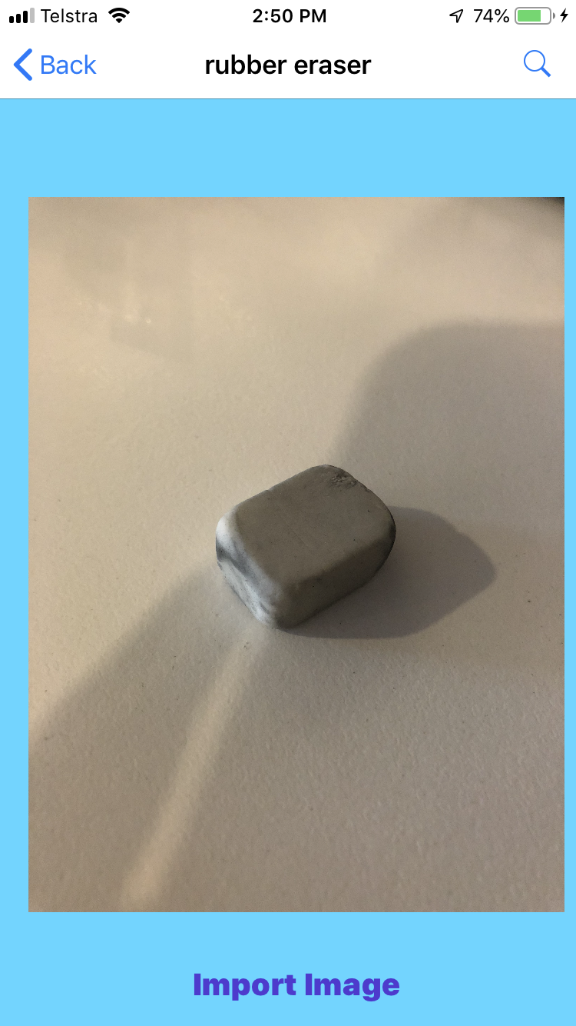
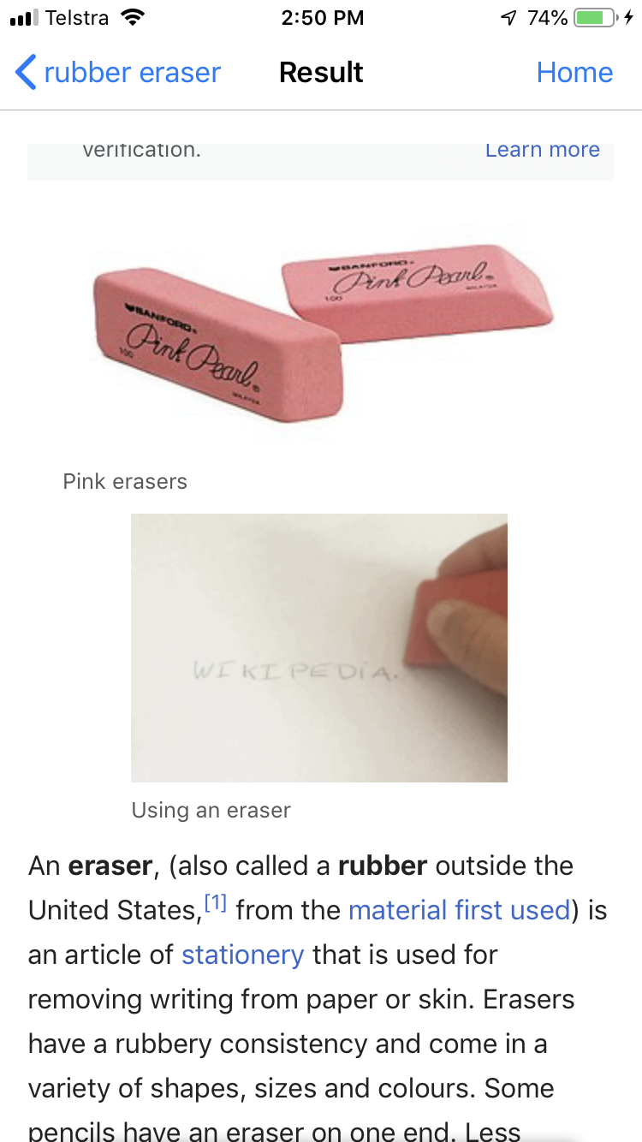
Import a Photo - 2

Slide 10

HISTORY

Slide 11
Framework
Core ML
Core ML delivers extremely fast performance with easy integration of machine learning models, enabling you to build apps with intelligent features using just a few lines of code.
You can easily build computer vision machine learning features into your app. Supported features include face tracking, face detection, tracking, and image registration and so on.
using one function of Core ML: image processing.

Slide 12
Product Design Cycle
First week: building a prototype
Next few weeks: enlarge the project through iteration.
In each iteration each teammate comes up with new idea and translates the idea into specific code.

Slide 13
Thank you!

